Slide 1
Book1
File created on: 1/31/24 4:12:49 PM EST

Slide 2
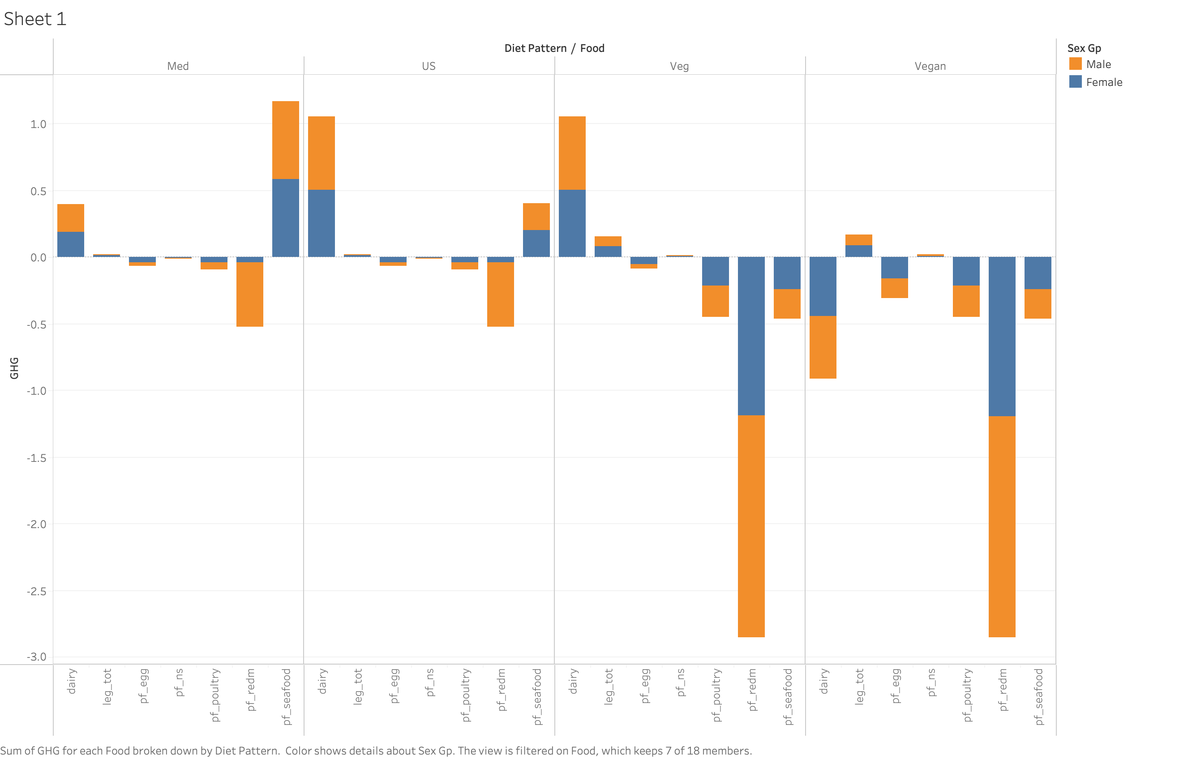

Slide 3
